Slide 1
Mapping customers A guide to interactive thematic maps for marketing analytics
andrea.bublitz@uzh.ch
Mapping customers
Salome Lang

Slide 2
Data visualizations are essential in marketing analytics and maps are a popular form of visualization
Introduction
To communicate results by visualizing them for internal and external stakeholders is an important task in marketing analytics
When the data includes geographic information (which is often the case with customer transaction data for example), an obvious option is to visualize it on a map
Furthermore, it is often desirable to let the addressee interact with the analysis, ask own questions, and directly get the according answers
 | The following presentation will guide you through the creation of an interactive thematic map on the example of a retailer’s customer transaction data

Slide 3
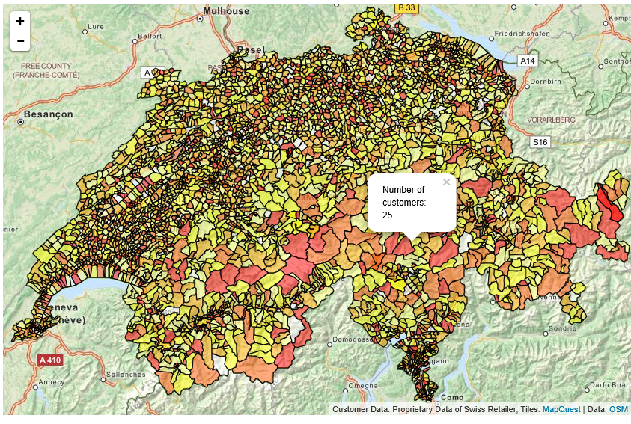
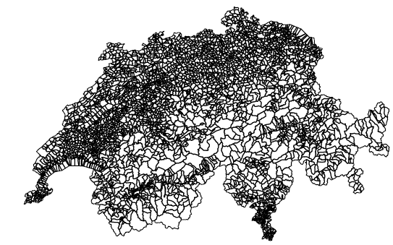
The weighted interactive map requires three inputs
Input/Output
Customer transaction data including geographical information
Input
Output
Customer ID | AggPurchase | ZIP code
565428 | 4,262.2 | 4532
171796 | 2,916.4 | 4436
810696 | 1,525.3 | 8006
Population statistics on same geographic layer
ZIP code | Total population | Female
1000 | 2,964 | 1,485
1003 | 8,269 | 4,126
1004 | 28,996 | 15,013
Shapefile containing the polygon shapes
Interactive thematic map of the customer data weighted by population size
Mapping Customers | Introduction to Geo-Marketing
Salome Lang
1

Slide 4
Mapping Customers Agenda
Outline
Introduction to Mapping
Data Screening
§ Implementation in R
Summary
References
1
2
3
4
5
Mapping Customers | Introduction to Mapping
Salome Lang
1

Slide 5
Imagine you consulted a retail firm…
Theory
Empirical studies suggest that advertising in retail stores is more successful if tailored to the local environment because location characteristics affect
The attractiveness of certain product categories
The preference for private labels
Customers’ reaction to store flyers and advertised deals
Relevant environmental variables are in particular
Socio-demographics of the inhabitants of the store’s trading area
Nature and intensity of local competition
Gijsbrechts et al. (2003)
Campo et al. (2000)
Mapping Customers | Introduction to Mapping
Salome Lang
1

Slide 6
… you would like to draw an informative map
Goal
Then you should avoid two major pitfalls in drawing thematic maps:
Maps are not a shortcut in your data screening process
Make sure your map answers the right question
 |  | Goal
 | To advertise more successfully, you want to provide a thematic map that facilitates decision making for the retailer.
Mapping Customers | Introduction to Mapping
Salome Lang
1

Slide 7
Visualizing data on a map is only the cherry on the cake
Pitfall I
Mapping attributes of spatial objects in R is a rather involved task
Therefore, it is even more important for your to know what the map should show you before you draw it, i.e.
Get to know your data by screening it carefully
Get simple descriptives, such as histograms, of your variables of interest before you plot the map
Mapping Customers | Introduction to Mapping
Salome Lang
1

Slide 8
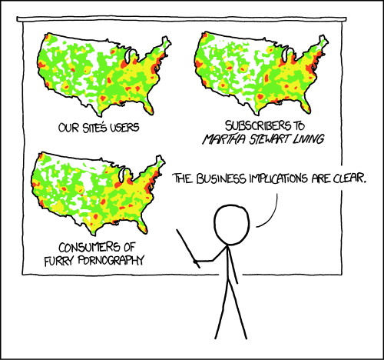
Maps of absolute values usually answer the wrong question
Pitfall II
Absolute values plotted on maps answer the question “Where do most people live?”, which is usually not the question of interest
https://xkcd.com/1138/
 | Now you know why we need population statistics as an input to the map
Mapping Customers | Introduction to Mapping
Salome Lang
1

Slide 9
Mapping Customers Agenda
Outline
Introduction to Mapping
Data Screening
§ Implementation in R
Summary
References
1
2
3
4
5
Mapping Customers | Data Screening
Salome Lang
2

Slide 10
To avoid pitfall I, we carefully screen the data
Screening
Data Set | Variable | Measurement |  |  | Descriptive Statistics
 |  | Range | Type | No. cases | No. missing values | Mean
Customer data | Customer ID | 3493-902016 | Integer | 156321 | 0 | -
 | AggPurchase | 0-394882 | Numeric | 156321 | 0 | 8983
 | PLZ | 1000-9658 | Integer | 156321 | 1518 | -
 | City | - | Character | 156321 | 1518 | -
Population statistics | PLZ | 1000-9658 | Integer | 3189 | 0 | -
 | Total | 1-38904 | Integer | 3189 | 0 | 2583
 | …
Mapping Customers | Data Screening
Salome Lang
2

Slide 11
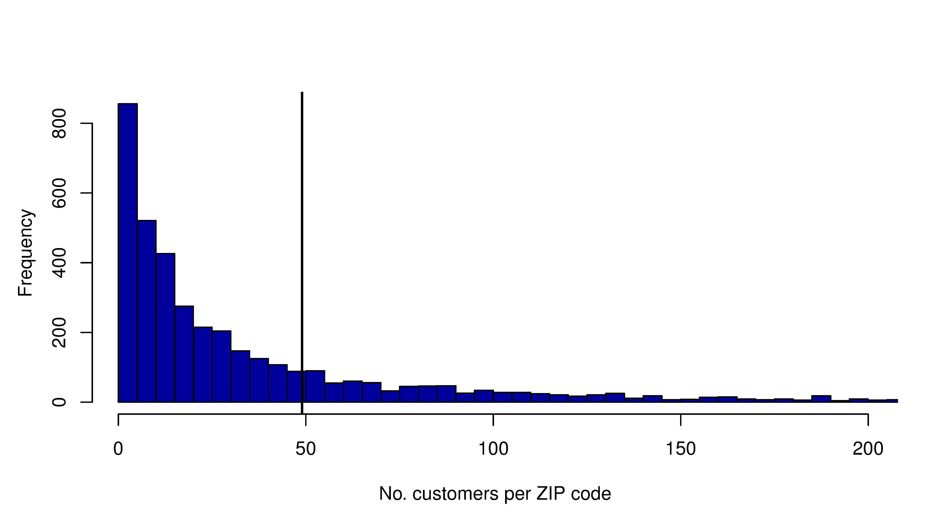
In half of the ZIP code areas, the retailer reaches less than 50 customers
Screening
Mean = 49.01
Mapping Customers | Data Screening
Salome Lang
2

Slide 12
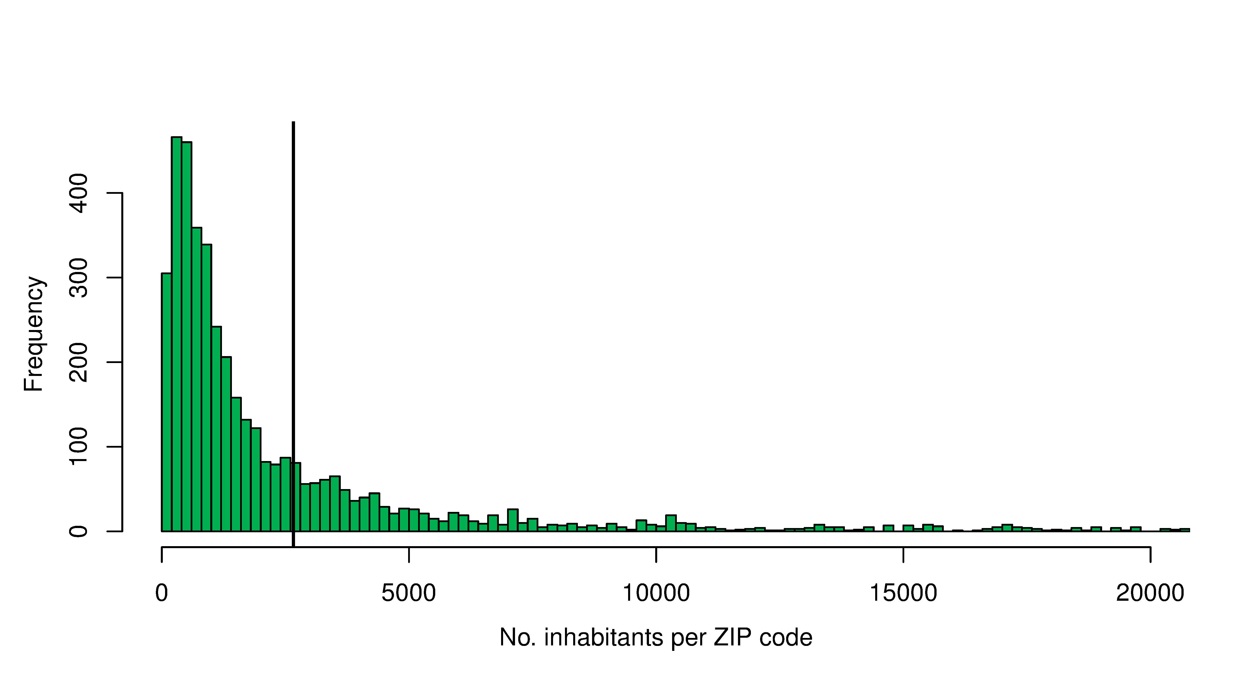
The population density in most Swiss ZIP code areas is smaller than 3000 inhabitants
Screening
Mean = 2663.18
Mapping Customers | Data Screening
Salome Lang
2

Slide 13
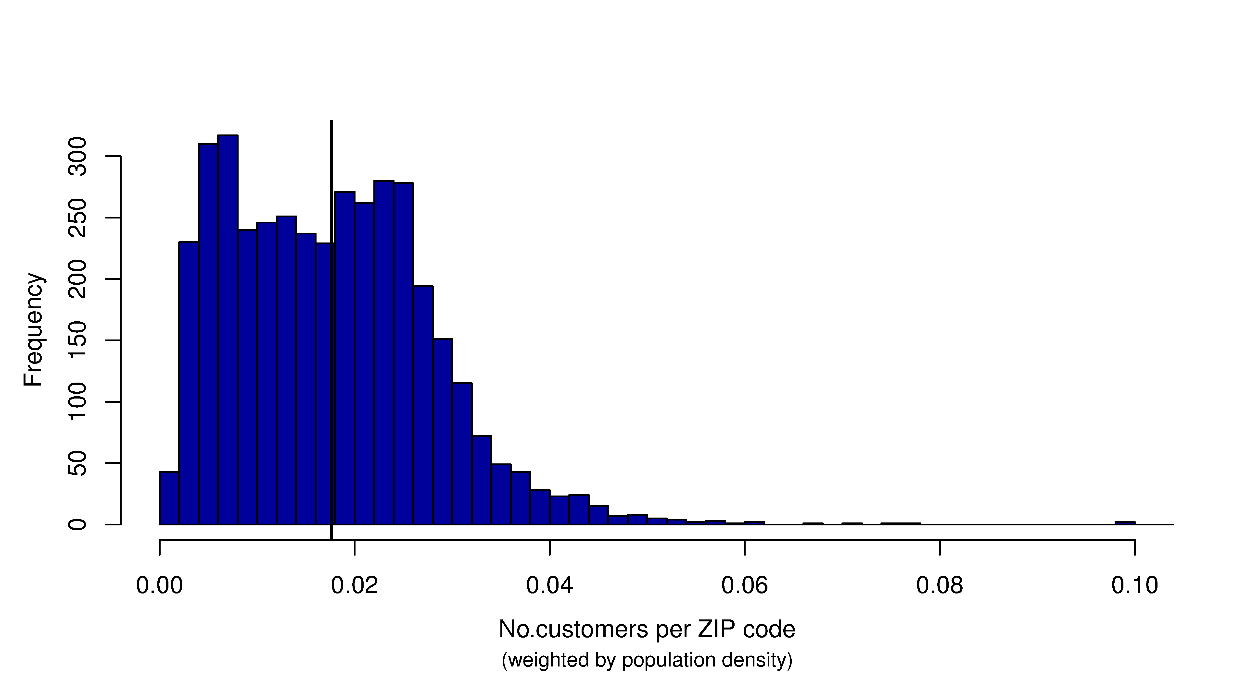
In most ZIP code areas, the retailer reaches less than 4% of the population
Screening
Mean = 0.0176
 | This is the variable of interest for the maps: number of customers weighted by population
Mapping Customers | Data Screening
Salome Lang
2

Slide 14
Mapping Customers Agenda
Outline
Introduction to Mapping
Data Screening
§ Implementation in R
Summary
References
1
2
3
4
5
Mapping Customers | Implementation in R
Salome Lang
3

Slide 15
Many packages offer mapping functions for R
Spatial data
The package {GISTools} is a good starting point to learn how to deal with maps in R (see also book Brunsdon and Comber, 2015)
R stores spatial data in a particular object class according to the spatial information it contains
Spatial information | Example | Respective R object
 |  | without attributes | with attributes
Points | Location of Coop stores in Oerlikon | SpatialPoints | SpatialPointsDataFrame
Lines | Streets in Oerlikon | SpatialLines | SpatialLinesDataFrame
Areas | ZIP codes areas in Oerlikon | SpatialPolygons | SpatialPolygonsDataFrame
 | To draw the customer density on Swiss ZIP codes, we will use a SpatialPolygonsDataFrame
Mapping Customers | Implementation in R
Salome Lang
3

Slide 16
A SpatialPolygonsDataFrame contains at least two parts
Spatial data
 | SpatialPolygonsDataFrame
 | The data frame | The polygons
Access sub-object | Objectname@data | Objectname@polygons
Sub-object class | Data.frame | List (of lists for each polygon)
Access variables of the data frame | Objectname@data$Variablename or directly Objectname$Variablename
Mapping Customers | Implementation in R
Salome Lang
3

Slide 17
If you remember anything of this presentation, it should be these two points
Implementation
There are two lines of code that may cost you an awful lot of time when dealing with maps
About merging attributes to shapefiles: Don’t touch the polygons!
If you want to plot your map on a base map to enable zoom and interactive features: Check the Coordinate Reference Systems (CSR) of the maps!
Mapping Customers | Implementation in R
Salome Lang
3

Slide 18
Don’t touch the polygons!
Important I
Often, you will have the attributes you want to plot (e.g. the customer data) in one data file and the according geographic information (e.g. the ZIP code areas) in another data file, usually a shapefile.
After you loaded both objects in R you want to merge the data frame of the attributes with the data frame of the SpatialPolygonsDataFrame.
The base function “merge” will do the job, but: don’t forget to add the option “all.x = TRUE” in order not to change the number of observations of the SpatialPolygonsDataFrame.
Mapping Customers | Implementation in R
Salome Lang
3

Slide 19
Don’t touch the polygons!
Important I
This is the customer data with population statistics
Merge by geographic layer, here ZIP codes
Overwrite the data frame of the SpatialPolygonsDataFrame
Otherwise, the number of observations in your data frame will differ from the number of polygons, which will lead to all sorts of problems, e.g.
it is not possible to save your new SpatialPolygonsDataFrame
depending on the package, the polygons are not plotted at all, etc.,etc.
 | s_merge_cust_pop_shape.R | R Code
 | ch@data <- merge(ch@data, cust.stat, by= "PLZ", all.x=T)
The most important part!
Important I
Mapping Customers | Implementation in R
Salome Lang
3

Slide 20
Check the Coordinate Reference Systems (CSR) of the maps!
Important II
CRS indicate a standardized way to describe locations.
Different sources use different CRS and the chosen CRS affects the way regional boundaries are drawn on a map.
More importantly, if you want to combine different maps in R, e.g. by plotting your map on top of a base map, you need to make sure to transform the spatial data to one common CRS.
Frazier, M.: Overview Coordinate Reference Systems
Mapping Customers | Implementation in R
Salome Lang
3

Slide 21
Check the Coordinate Reference Systems (CSR) of the maps!
Important II
proj4string() to inspect the CRS of a SpatialPolygonsDataFrame
Otherwise, R will only plot one map instead of combining several ones without giving any error or warning.
 | s_merge_cust_pop_shape.R | R Code
 | proj4string(ch) # is not EPSG:4326 ch <- spTransform(ch, CRS("+init=epsg:4326"))
This is the most important line!
spTransform() to change the current CRS
I transform the CRS to EPSG:4326 because this is the CRS that the package {rleafmap} uses to draw its base maps. I will use {rleafmap} later on to plot interactive,
zoomable maps.
 | Now that we have merged the attributes to the spatial object and transformed the maps to a common CRS, we can go ahead and plot the interactive maps
Frazier, M.: Overview Coordinate Reference Systems
Mapping Customers | Implementation in R
Salome Lang
3

Slide 22
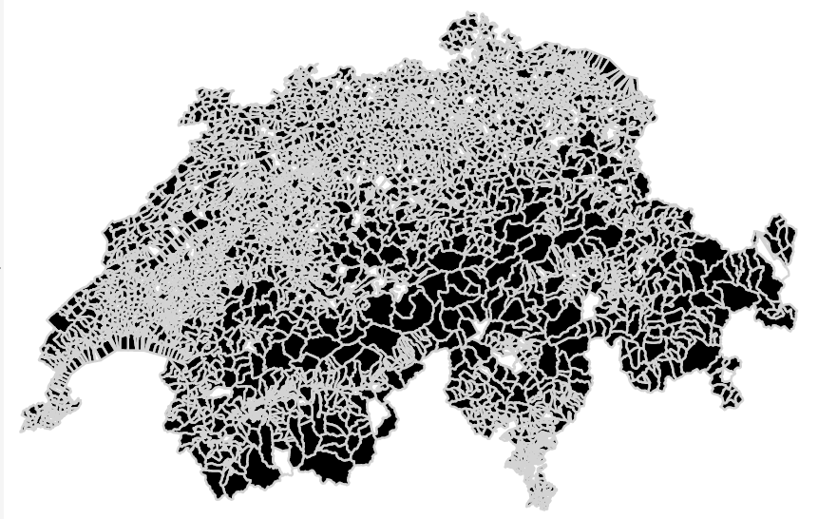
The first map shows the ZIP codes in which the retailer has at least one customer
Maps
Mapping Customers | Implementation in R
Salome Lang
3

Slide 23
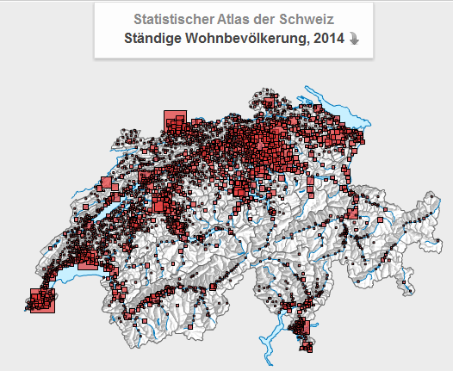
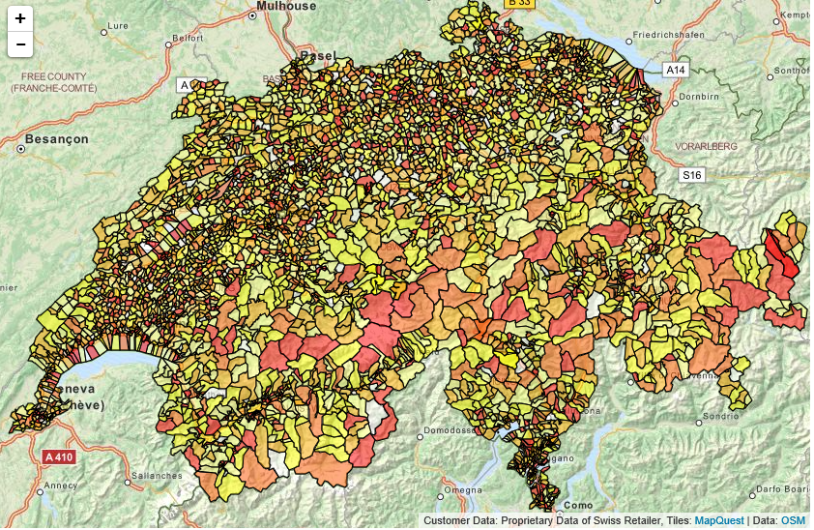
The plot with the absolute numbers answers the wrong question
Maps
The brighter areas are the ones with more customers
The official population statistics show a very similar map
https://www.atlas.bfs.admin.ch/maps/13/map/mapIdOnly/0_de.html
Maps
Mapping Customers | Implementation in R
Salome Lang
3

Slide 24
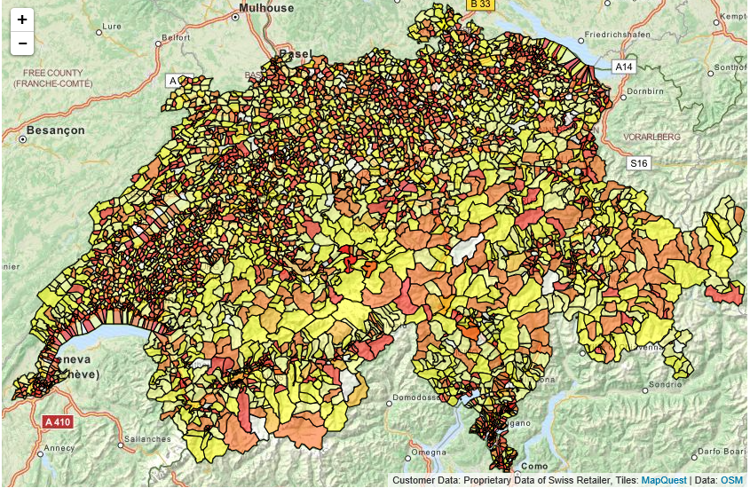
This the map for the number of customers weighted by population density…
Maps
Mapping Customers | Implementation in R
Salome Lang
3

Slide 25
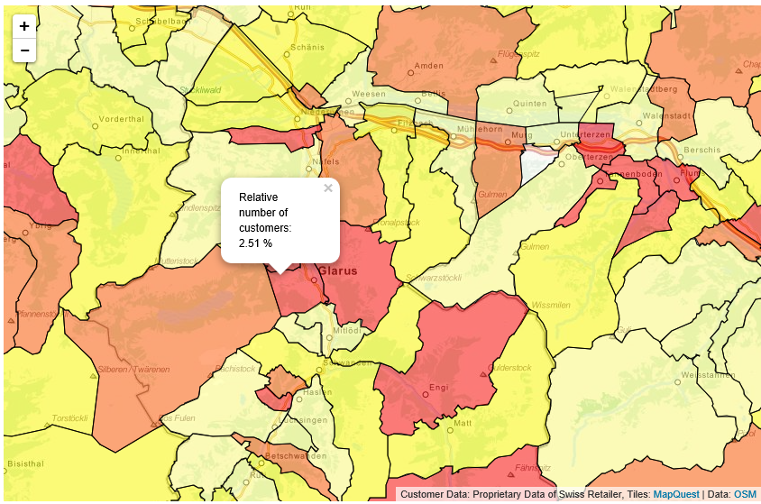
…and it has pop ups and a zoom
Maps
Mapping Customers | Implementation in R
Salome Lang
3

Slide 26
Mapping Customers Agenda
Outline
Introduction to Geo-Marketing
Data Screening & Descriptives
§ Implementation in R
Summary
References
1
2
3
4
5
Mapping Customers | Summary
Salome Lang
4

Slide 27
Maps may not always be more useful, but they are pretty…
Summary
In practice, many analytical questions can be answered with histograms and scatter plots just as well as with a map.
If you decide to visualize your data on a map nevertheless, be aware that
Maps are not a shortcut in your data screening process
Often, you need to weight values by population to answer the right question
Don’t touch the polygons
Check the CRS in combine several maps
 | Once you have tackled how spatial data objects work, R offers so much flexibility in drawing maps (not comparable to Stata for example). Even if a histogram answers the question as well as a map, the map are definitely more impressive…
Mapping Customers | Summary
Salome Lang
4

Slide 28
References
References
Brunsdon, Chris, and Lex Comber. An Introduction to R for Spatial Analysis Et Mapping. London: Sage, 2015.
Campo, K., Gijsbrechts, E., Goossens, T., & Verhetsel, A. (2000). The impact of location factors on the attractiveness and optimal space shares of product categories. International Journal of Research in Marketing, 17(4), 255-279.
Frazier, M.: Overview of Coordinate Reference Systems (CRS) in R. Link: https://www.google.ch/url?sa=t&rct=j&q=&esrc=s&source=web&cd=1&cad=rja&uact=8&ved=0ahUKEwi_xrqHirjJAhUDIg8KHbMOB3sQFggeMAA&url=https%3A%2F%2Fwww.nceas.ucsb.edu%2F~frazier%2FRSpatialGuides%2FOverviewCoordinateReferenceSystems.pdf&usg=AFQjCNHm-nq1ZLij4bTWVM-5SR4Ygs-Xyw&sig2=JZtr4LpwkR9fxzOJtpJjEw
Mapping Customers | References
Salome Lang
5

Slide 29
References
References
Gijsbrechts, E., Campo, K., & Goossens, T. (2003). The impact of store flyers on store traffic and store sales: a geo-marketing approach. Journal of Retailing, 79(1), 1-16.
Keck, François. Rleafmap: interactive maps with R and leaflet. http://www.francoiskeck.fr/rleafmap/
Mapping Customers | References
Salome Lang
5

Slide 30
Social Customer Relationship Management: Group Assignment
Salome Lang salome.lang@uzh.ch
Mapping Customers

